Slide 1

RFID based Attendance Monitoring System

Slide 2
Department of Applied Electronics and Instrumentation Engineering
Academy of Technology
Project Guide: Prof. Hiranmoy Mandal
Presented By:
Snehasish Malik (11). Bratati Rout (43), Ahana Das (57),
Debapriya Bose (41), Hirak Das (36), Soumalya Sen (10).

Slide 3
T O P I C S
1
I N T R O D U C T I O N
T H E O R Y
2
3
W O R K I N G
4
C O N C L U S I O N

Slide 4
INTRODUCTION
1

Slide 5
Objective
RFID
Digital information.
Unique ID.
Contactless.
Great response time.
Arduino
Open-source.
Widely used.
Cheap.
Easy to program & debug.
Implementing IoT
Digitalization of the process.
Complete monitoring over the internet.
Very little human effort required.

Slide 6
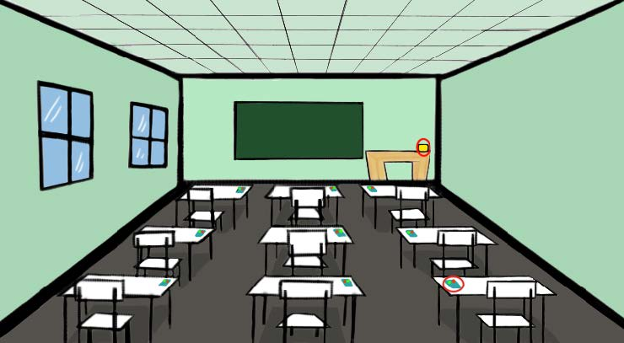
Proposed system
Automates the attendance taking process.
Reduces time and increases efficiency.
Enforces Security.
Scalable, easy to manage and easy to monitor.

Slide 7
THEORY
2

Slide 8
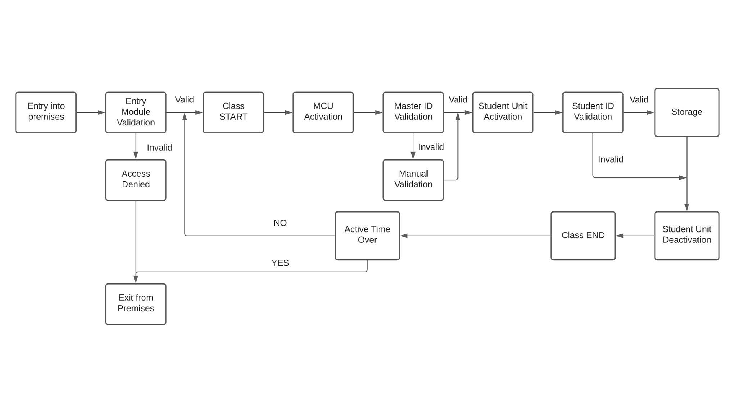
Block diagram of the proposed system

Slide 9
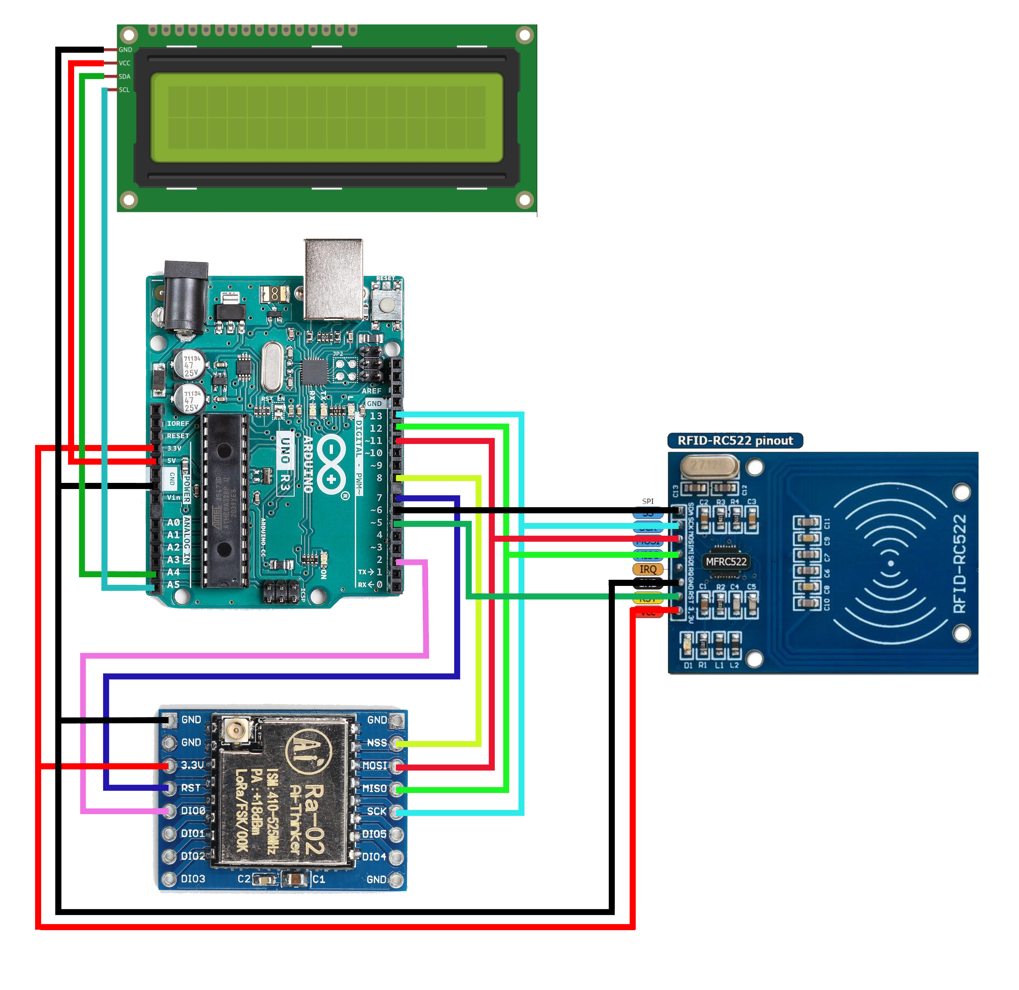
Technology Used
RC522 RFID reader is used for reading information from the RFID tags/cards.
Arduino Uno or Nano is used as the microcontroller.
LoRa is used as the communication layer and protocol.
LCD is used to display the necessary information for visual aid.

Slide 10


RFID
Arduino
Provides an Unique ID.
Line of Sight not required.
Contactless information sharing.
Battery-less operation.
Can detect through obstacles.
Open-source in hardware and software and Inexpensive.
Does not require an external programmer.
Arduino IDE is supported in almost every OS.
Ease of Programming.
A very large and growing community.

Slide 11

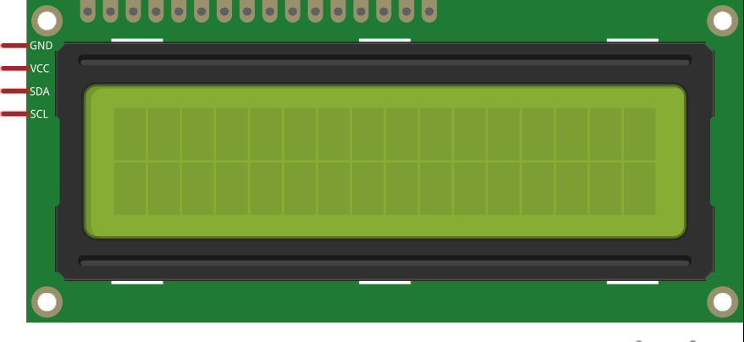
LoRa
LCD
Provides deep indoor coverage.
Low-power.
Low-cost.
High capacity.
It is a 16x2 LCD.
Provides visual info.
Uses I2C protocol.
Depicts status of the process.

Slide 12
WORKING
3

Slide 13
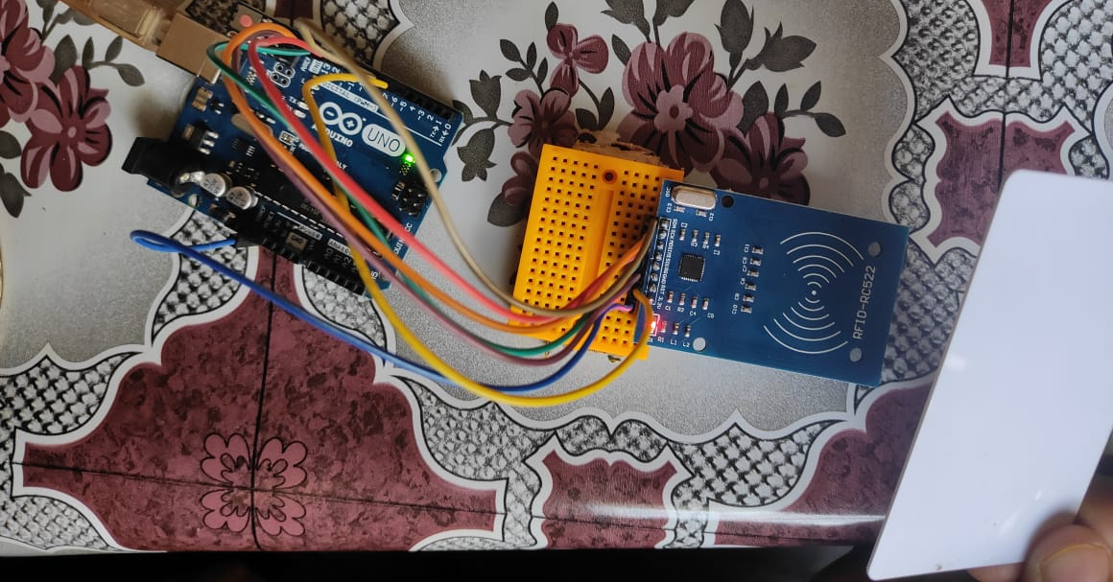
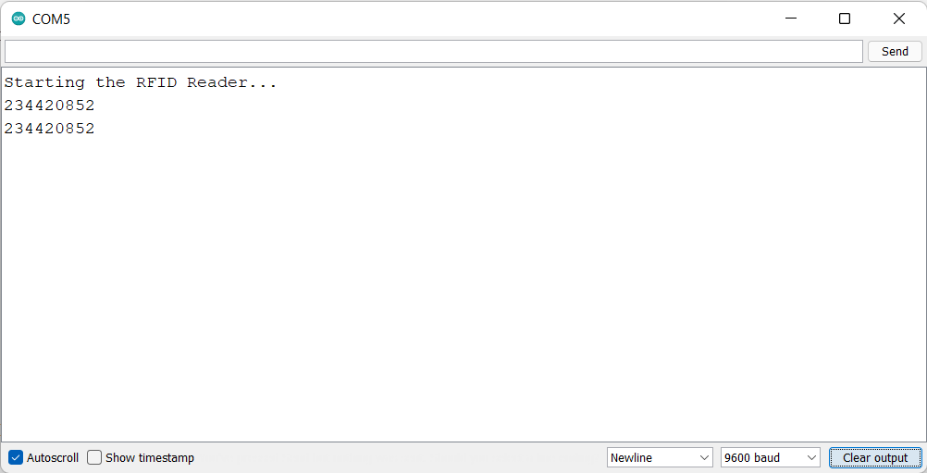
Reading info from the RFID Card
Picture showing the RFID reader detecting and printing the Tag value.

Slide 14
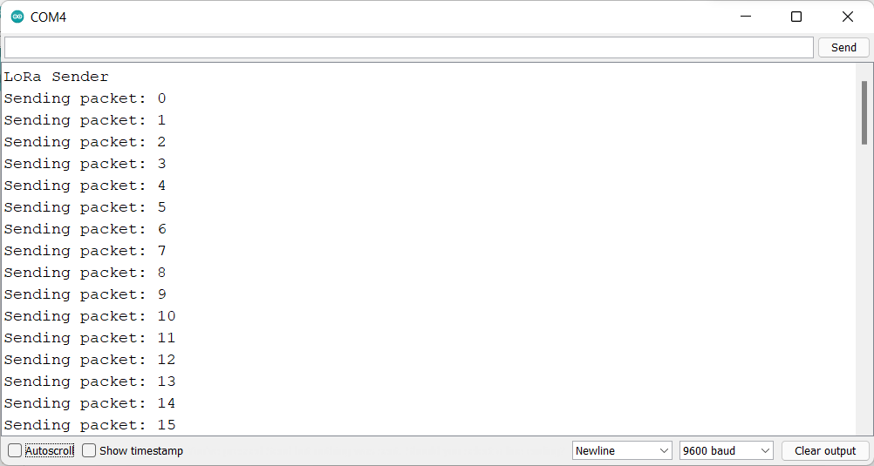
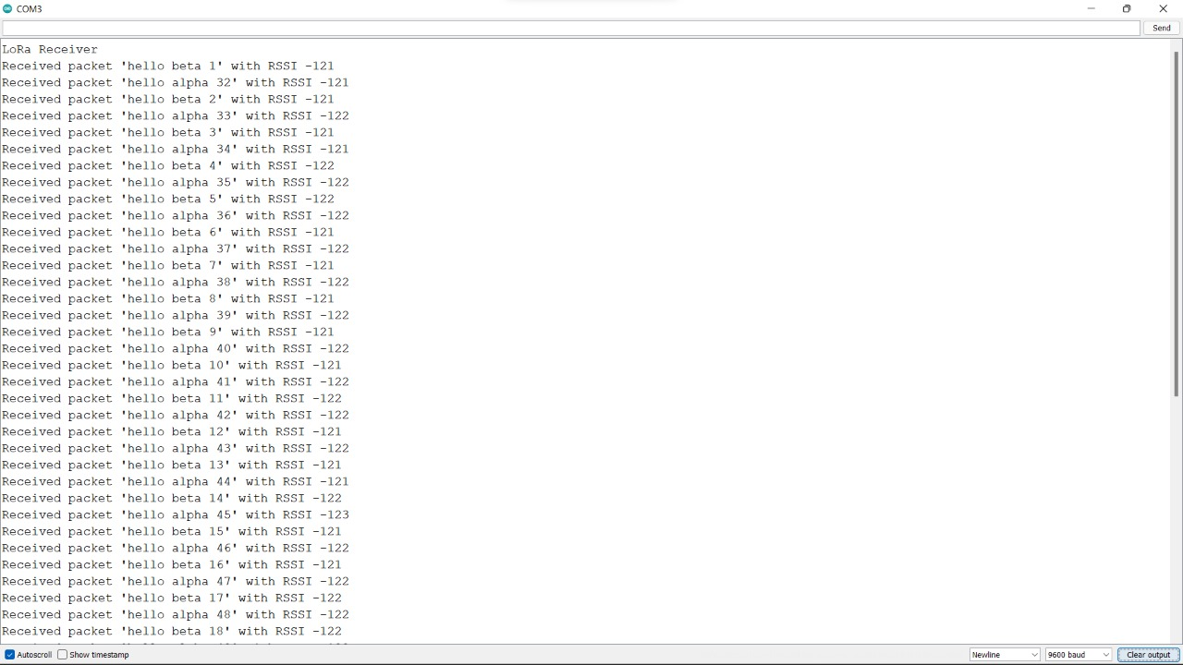
Communicating using LoRa
The LoRa module is used to send and receive data packets to and from end nodes.
The same is shown below:
Figure showing LoRa sending data packets
Figure showing LoRa receiving data packets

Slide 15
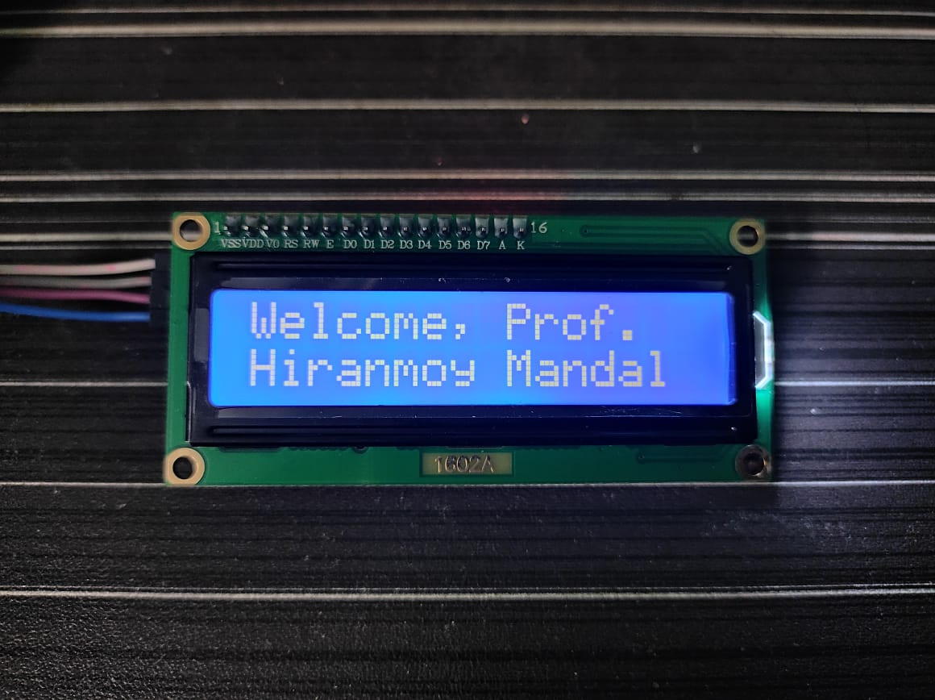
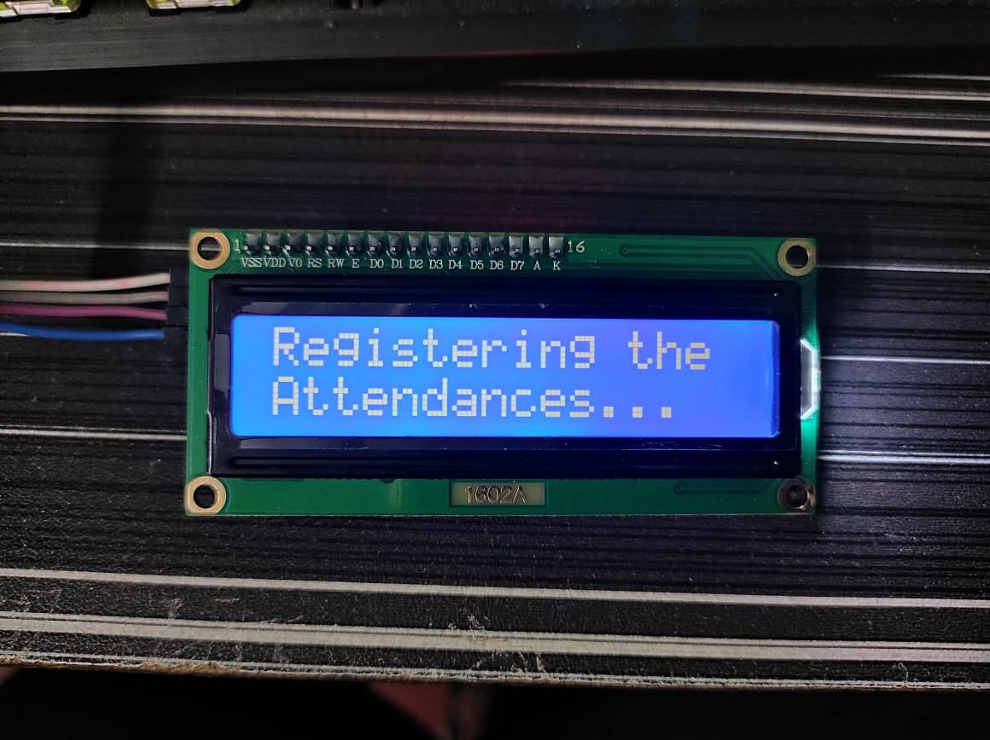
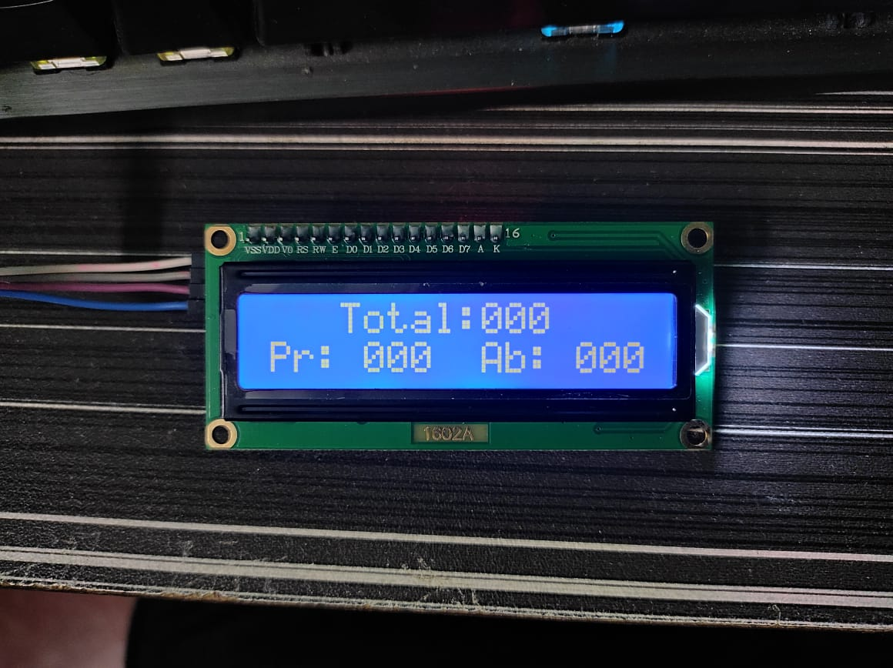
Customising the LCD
We are able to customise the LCD based on our needs like:
Displaying a Welcome message.
Status of the process.
Necessary numbers and values.

Slide 16
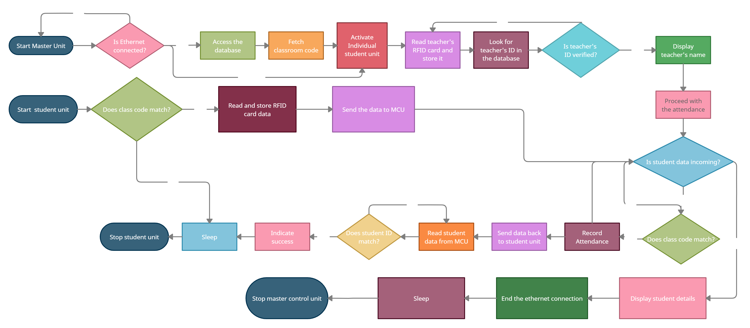
Flowchart of the process

Slide 17
Part of the works to be
completed in upcoming semester
Interfacing the Master Control Unit with an Internet connectivity via Ethernet.
Creating and implementing the database and connections.
Implementing the Entry control module.
Testing the model as a whole and enhancing the methods, if possible.

Slide 18
CONCLUSION
Automation
Saves time.
Reduces errors.
Less human effort.
Low Cost
Most of the components and software are open-source.
Relatively cheaper than other comparable/similar technologies available.
Better Operability
Simple Interface.
Easy to use & operate.
Abstract design.
Advantageous
Digitalization of data.
Low response time.
Simultaneous registering of attendance.
Low maintenance
Battery operated.
Very low power consuming components and techniques.
Future Scope
Adopt in other organisation to cater their needs.
Include parts to enhance or change certain requirements.

Slide 19
References
Gatsheni, B.N., R.B. Kuriakose, and F. Aghdasi. Automating student class attendance register using radio frequency identification in South Africa, in Mechatronics, ICM2007 4th IEEE International Conference in 2007.
Mahyidin, M.F. Student Attendance Using RFID System 2008; Available from: http://umpir.ump.edu.my.
T. S. Lim, S.C. Sim, M. M Mansor. RFID Based Attendance System. 2009 IEEE Symposium on Industrial Electronics and Applications (ISIEA 2009), Kuala Lumpur, Malaysia, October 4-6, 2009.

Slide 20
THANK YOU 🤝

